Slide 1
Austin Real Estate
Income and crime

Slide 2
Hypothesis & Key Questions
Austin has experienced rapid growth over the past twenty years. This has brought a lot of jobs to the downtown area and in turn many zip codes around the city center are experiencing rapid gentrification.
Is there a correlation between increasing housing prices and the number of burglary’s?
Does crime affect home prices?
Does household income increase at the same rate of housing prices?

Slide 3
Approach | Data Sources
Datasets:
City of Austin Census
Income, Population, Poverty Rate, Age, Year, Zipcode
ATTOM API – API Call
Property ID, Property Zip Code, Appraisal History, Years
data.austintexas.gov(Crime Report)– CSV
Crime categories and instances of each, Zip code, Year

Slide 4
Approach | Data Exploration/Cleaning
Census Data:
Pulled from python module
Read in Python leveraging Pandas module
Created data frame and grouped by zip code
Exported as CSV for visualization

Slide 5
Approach | Data Exploration/Cleaning
Crime Data:
Downloaded CSV from data.austintexas.gov
Read CSV in Python leveraging Pandas and Numpy starting with a total of 2135774 rows and 27 columns
Reduced dataframe down to five columns
Ran a for loop to create a new list and performed a groupby function to break out the data frame as shown.

Slide 6
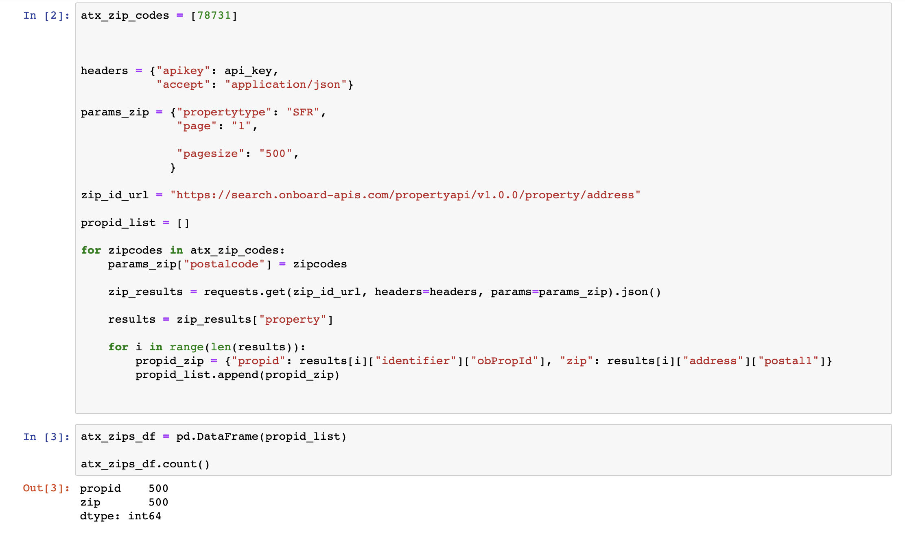
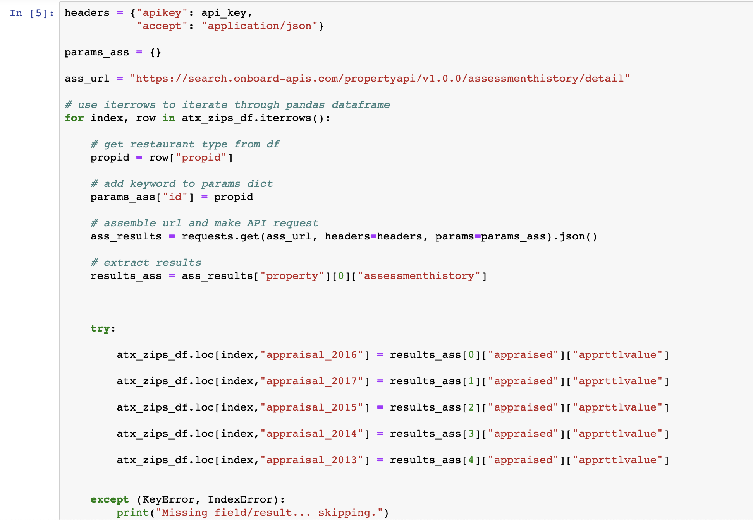
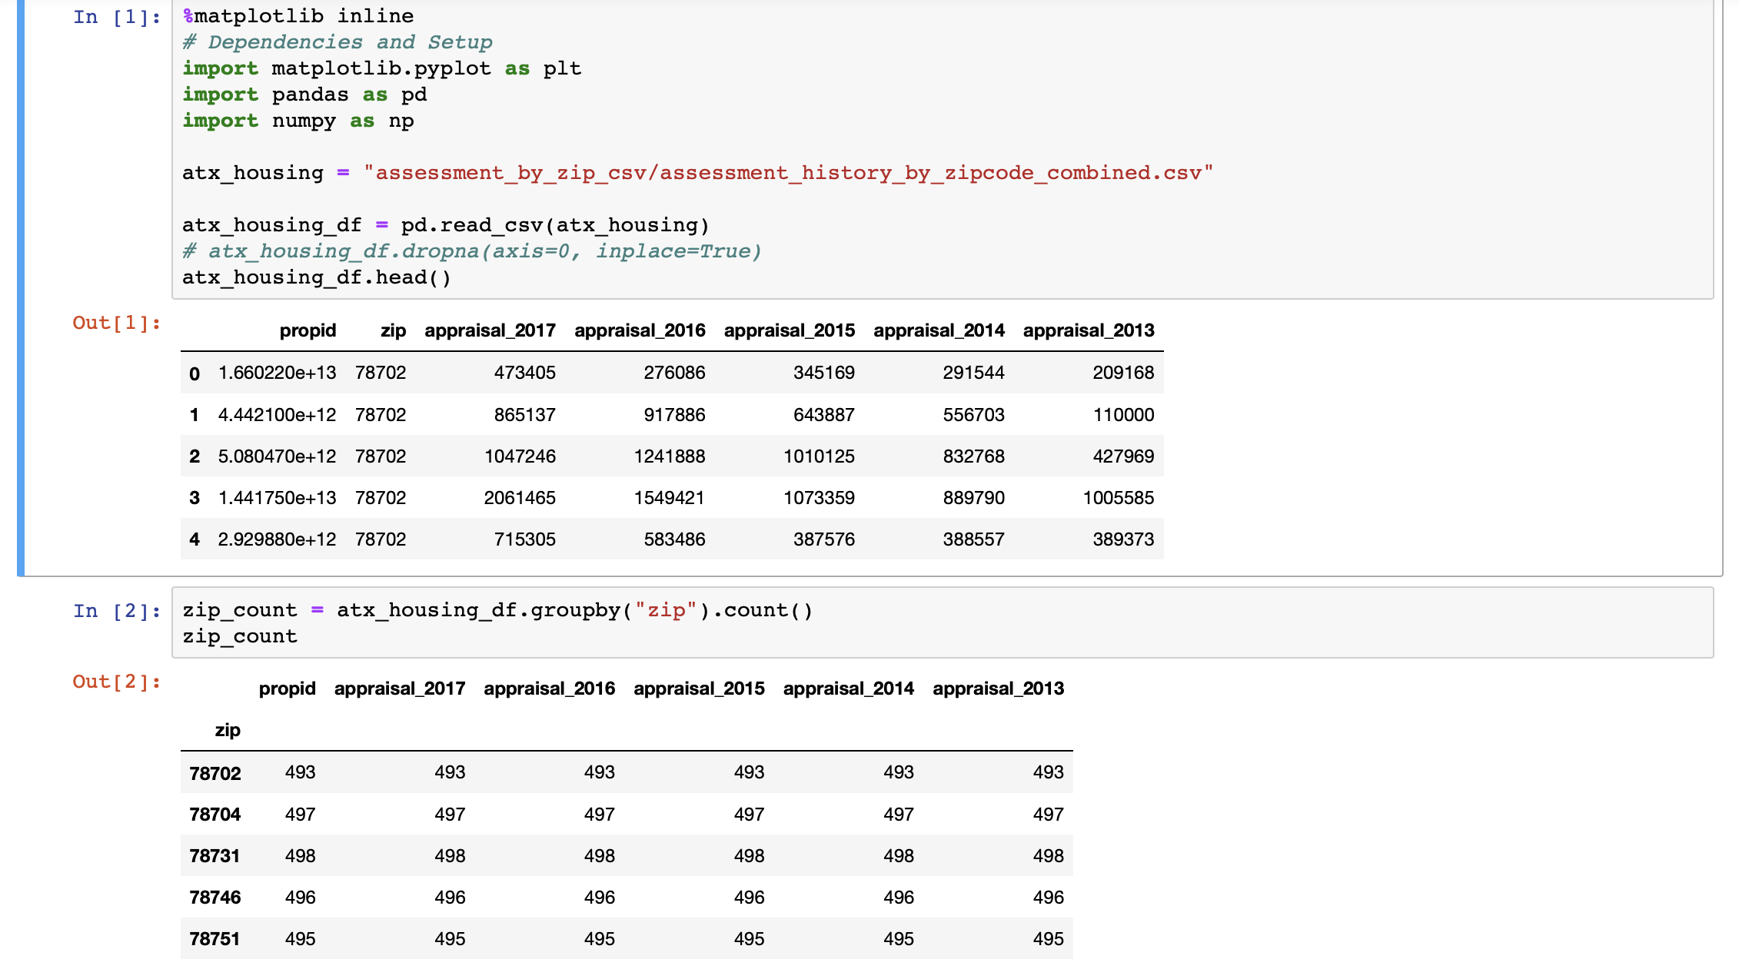
Approach | Data Exploration/Cleaning
Housing Data:
Performed two API calls from ATTOM
Leverage Python and a number of modules to clean and organize appraisal values by zip codes.

Slide 7
Analytics view Household Income

Slide 8
Analytics view (Crime)

Slide 9
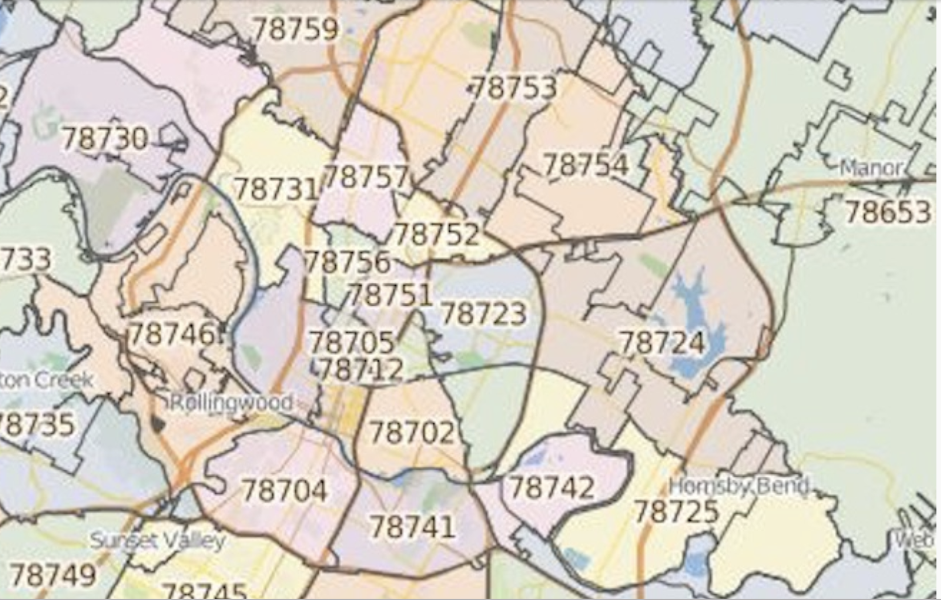
78702

Slide 11
78704

Slide 13
78731

Slide 15
78746

Slide 17
78751

Slide 19
ALL: 78702, 04, 31, 46, 51

Slide 22
Conclusions:
- The two zip codes (78702 & 78704) with the highest number of crimes had the largest increase in home prices over the same period.
Crime rates in all zip codes decreased over the 5 year period measured.
Home prices in all zip codes increased over the 5 year period measured.
Zipcode 78751 has the highest home price to income ratio which makes it the least affordable zipcode based on the metrics.
There is a widening gap between home prices and income making the areas around the city center less affordable.

